Slide 1


Deep Learning on 3D meshes via Model Simplification Project Presentation
June 4th, 2018
Presenter : Cleres David, CSE – Master 2
Supervisor: Prof. Pascal Fua
École Polytechnique Fédérale de Lausanne – EPFL
CVLAB

Slide 2
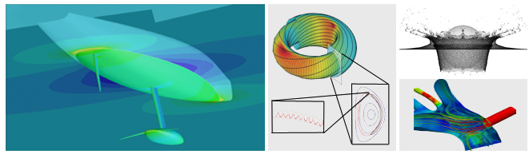
Computational Science & Engineering (CSE)
CSE Semester Project = 8 ECTS (during the semester)
Rules
The project takes between 1 and 1.5 days / week.
Weekly supervision through meetings with the PhD/ Post-Doc Student
Report at the end of the project
Oral presentation
Source: EPFL website
Notes:
About the lab

Slide 3
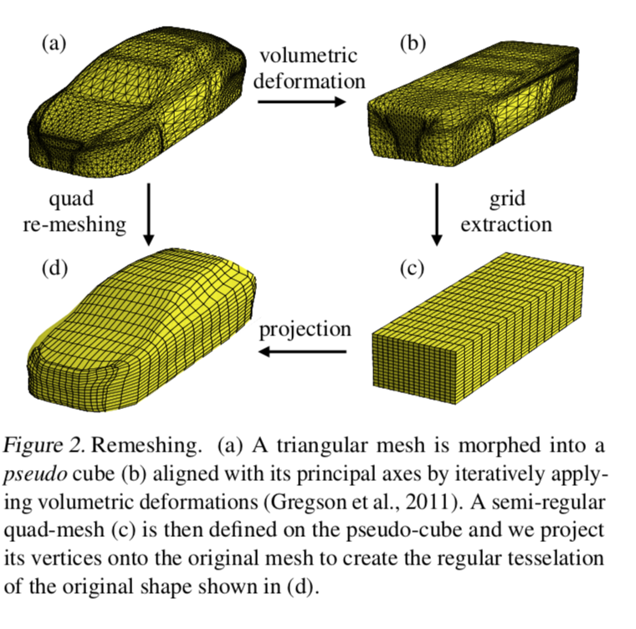
Basics in Polycube Mapping
Source:
Notes:
Aerodynamic shape optimization plays a major role in many applications to aircraft, cars, trains, turbines, internal pipe flows, and cavities, among others. With the ever increasing computational power during the passed 60 years, automated design optimzation procedures and Computational Flow Simulation (CFD) have become more competent. However, the state-of-the art methods used in industry are so computationally demanding that typical engineering practices are to either simply try a limited umber of hand-designed shapes or restrict oneself to shapes that can be parameterized using only few degrees of freedom. The use of artificial neural networks (ANN) in order to emulate a fluidynamics simulator by training Geodesic Convolutional Neural Networks outperforms the industrial methods by 5 to 20\% for standard problems and, even more importantly and applies to cases that previous methods cannot handle. However, the generation of Polycubic structures still require important amount of resources, an issue tackled in this document by using Deep Learning to learn how to generate these simplified structures starting from a standard STL file.
The goal of this project is to explore how polycube model simplification can be utilized to perform deep learning on 3D meshes efficiently: in particular the aim is to implement a polycube mapping algorithm and create a dataset of simplified models with it. Once such data-set is created 3D CNNs can be exploited to obtain efficient solid model simplification.
This report starts with a description of the dataset. Then, the basic principles of CNN will be presented and the computational time needed to generate an accuracy polycube structure using a CNN will be compared to the time needed by the algorithm that was generated to create the ground-truth answers of the initial training set. Section IV will be dedicated to present the results of the different neural net architectures and regressions that were used to perform a reliable prediction. Finally, discussion and auto-critic on the results will be made in this final part of the report.

Slide 4


Project Timeline
Reading papers about Voxelization techniques, shape simplification, …
Automatic Generation of the cubes car shapes
Step 2
Step 4
Step 1
Step 3
Step 5
Set-up meetings with Edoardo
Getting started on meshes
Training a deep neural network to learn the “cubification”
Implementation of the solid voxelization
Notes:
About the lab

Slide 5
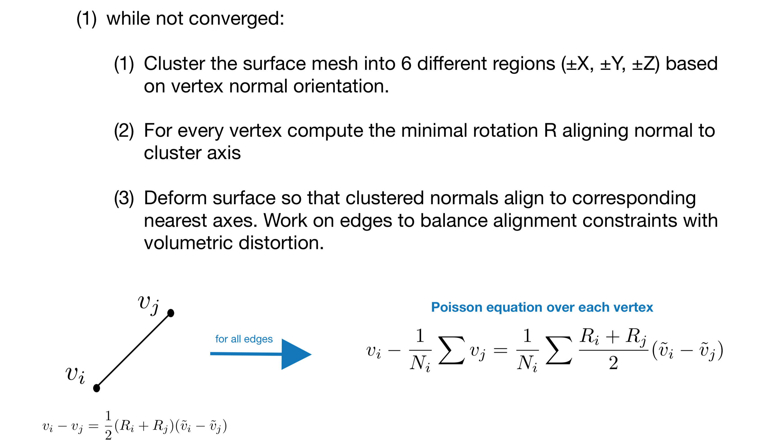
Axis Aligning Deformation
Iteratively deform a geometric model into a geometrically regular axis aligned shape
The Algorithm:
Notes:
About the lab

Slide 6
Volumetric Voxelization
Voxelize the axis aligned model by sampling the model signed distance function on a regular grid defined over the model’s bounding box
Notes:
About the lab

Slide 7
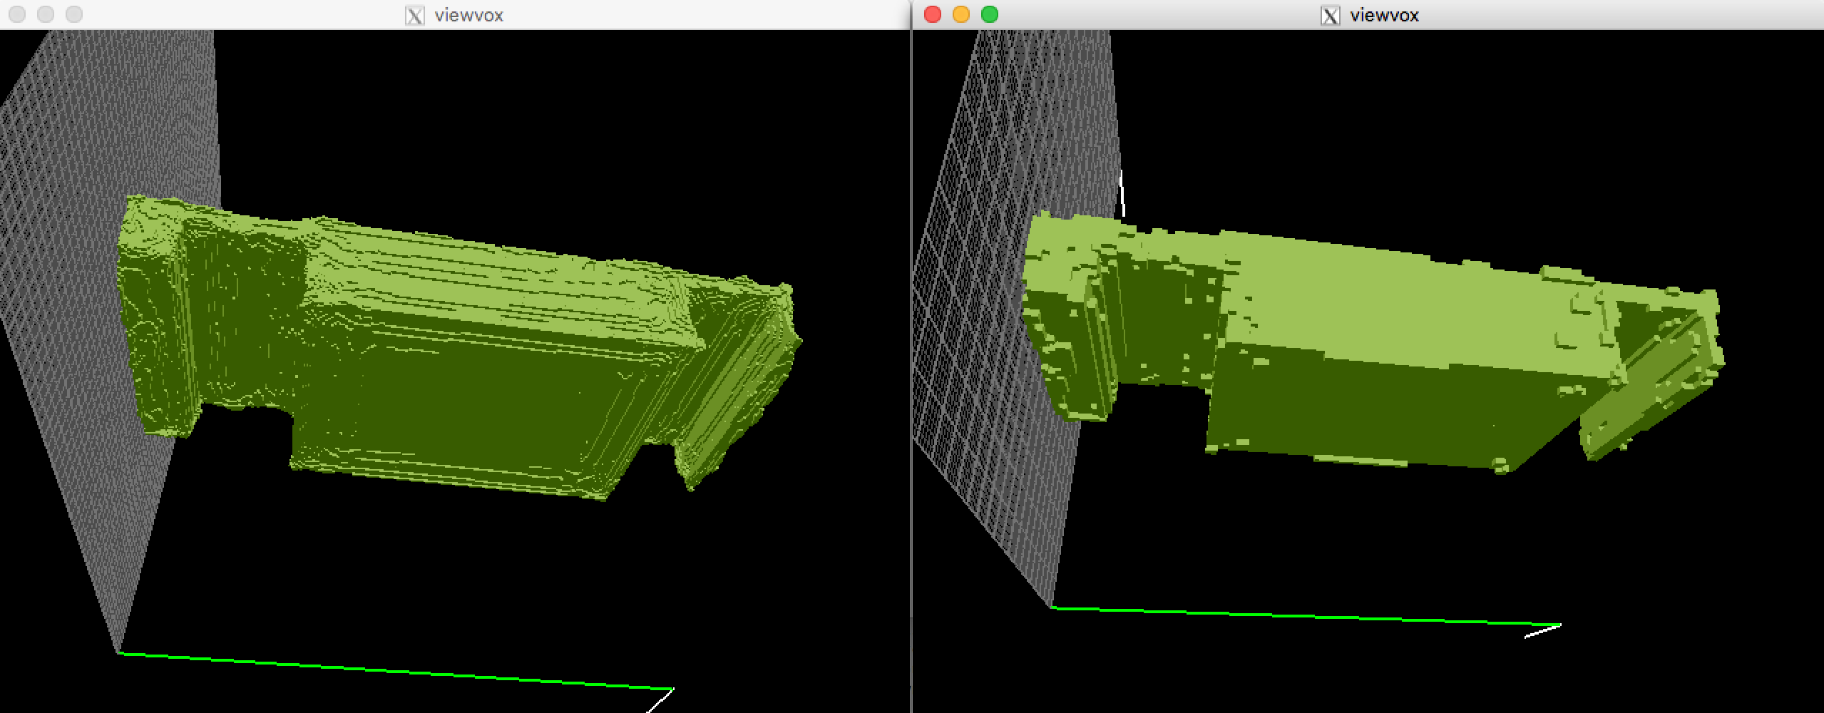
Examples
Grid Size = 256
Grid Size = 100
Notes:
About the lab

Slide 8
Find the Corners in the 3D Structure
Create the accumulator space, which is made up of a cell for each voxel, and set each cell to zero
Local Voting: for each boundary voxel (i,j,k) increment by 1 all cells that belong to the axis aligned planes centered in voxel (i,j,k) and to the neighborhood of the voxel
Search for local maxima in the accumulator space, these voxels represent the corners in the binary volume detected by the algorithm
• Find poly cubes in the domain by finding matching corners

Slide 9
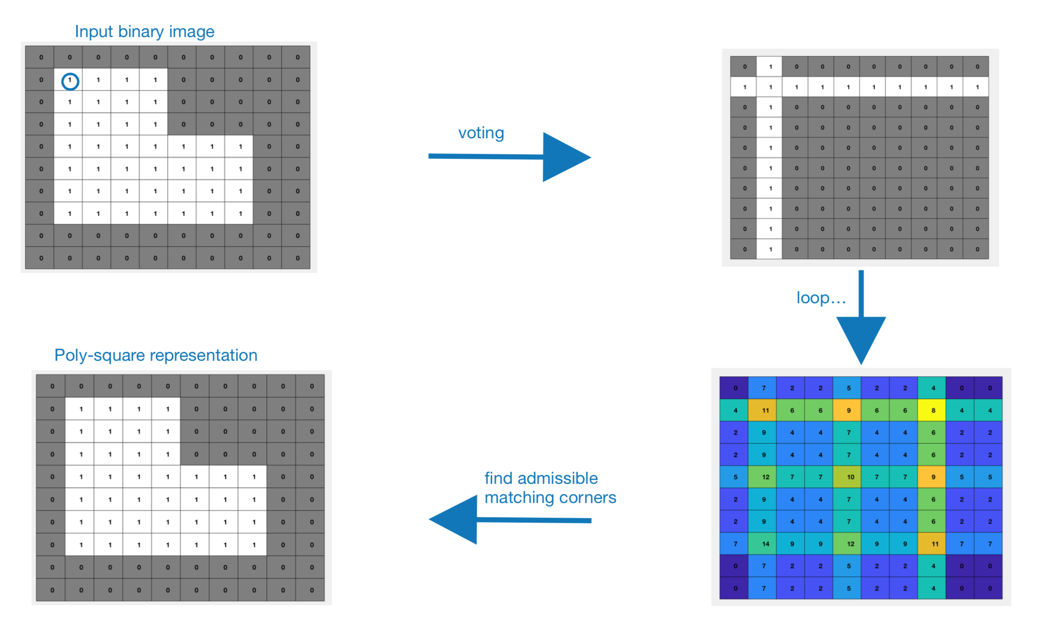
Voting

Slide 10
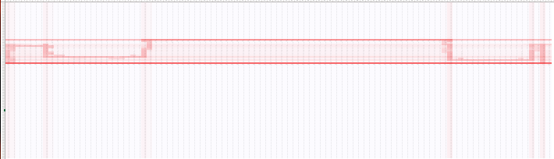
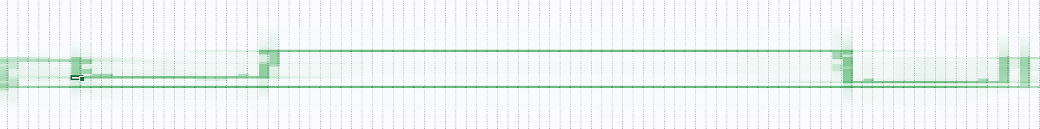
Find the Corners in the 3D Structure

Slide 11
Results
Comparison avec le script matlab de EDO

Slide 12

Where is the deep Learning?

Slide 13
The Dataset
Raw Dataset: collection of 1221 stereolithography (STL) files containing discretized shapes of cars
Processed using the C++ pipeline to generate cubes
(Poly)cube structures were then used as the ground-truth of the training set
Voxelized meshes were used as input for the artificial neural network
Notes:
The raw dataset consisted of a collection of 1221 stereolithography (STL) files containing the discretized shapes of cars. These data was processed using the C++ pipeline that will be explained in the \textit{method} section. By using this program, one was able to generate a Polycube structure starting from the given STL files (Fig. \ref{fig:fig1} \& \ref{fig:fig2}). These Polycube structures were then used as the \textit{Ground-truth representation (GT)} files of the training set, whereas the given files were used as input for the artificial neural network that was developed.

Slide 14
Preprocessing & Data Augmentation
Data was split in Training and Validations set

Slide 15

The (deep) Convolutional Neural Network

Slide 16
Model 1 vs. Model 2

Slide 17
Results

Slide 18
References
Baqué, P., Remelli, E., Fleuret, F., & Fua, P. (2018). Geodesic Convolutional Shape Optimization. Retrieved from http://arxiv.org/abs/1802.04016
Alliez, P. and Cohen-Steiner, D. and Tong, Y. and Desbrun, M. (2007). Voronoi-based variational reconstruction of unoriented point sets. Proceedings of the Fifth Eurographics Symposium on Geometry Processing, 39–48. https://doi.org/10.1145/1281991.1281997
Monti, F., Boscaini, D., Masci, J., Rodolà, E., Svoboda, J., & Bronstein, M. M. (2017). Geometric deep learning on graphs and manifolds using mixture model CNNs. Proceedings - 30th IEEE Conference on Computer Vision and Pattern Recognition, CVPR 2017, 2017–January, 5425–5434. https://doi.org/10.1109/CVPR.2017.576
Yu, W., Zhang, K., Wan, S., & Li, X. (2014). Optimizing polycube domain construction for hexahedral remeshing. CAD Computer Aided Design, 46(1), 58–68. https://doi.org/10.1016/j.cad.2013.08.018
Bommes, D., Campen, M., Ebke, H.-C., Alliez, P., & Kobbelt, L. (2013). Integer-grid maps for reliable quad meshing. ACM Transactions on Graphics, 32(4), 1. https://doi.org/10.1145/2461912.2462014
Bommes, D., Lévy, B., Pietroni, N., Puppo, E., Silva, C., Tarini, M., & Zorin, D. (2013). Quad-mesh generation and processing: A survey. Computer Graphics Forum, 32(6), 51–76. https://doi.org/10.1111/cgf.12014
Tarini, M. (2004). PolyCube-Maps. ACM Transactions on Graphics, 23(2), 853–860. https://doi.org/10.1145/1015706.1015810
Umetani, N. (2017). Exploring generative 3D shapes using autoencoder networks. SIGGRAPH Asia 2017 Technical Briefs on - SA ’17, 1–4. https://doi.org/10.1145/3145749.3145758

Slide 19
Questions ?

Slide 20


